Slide 1
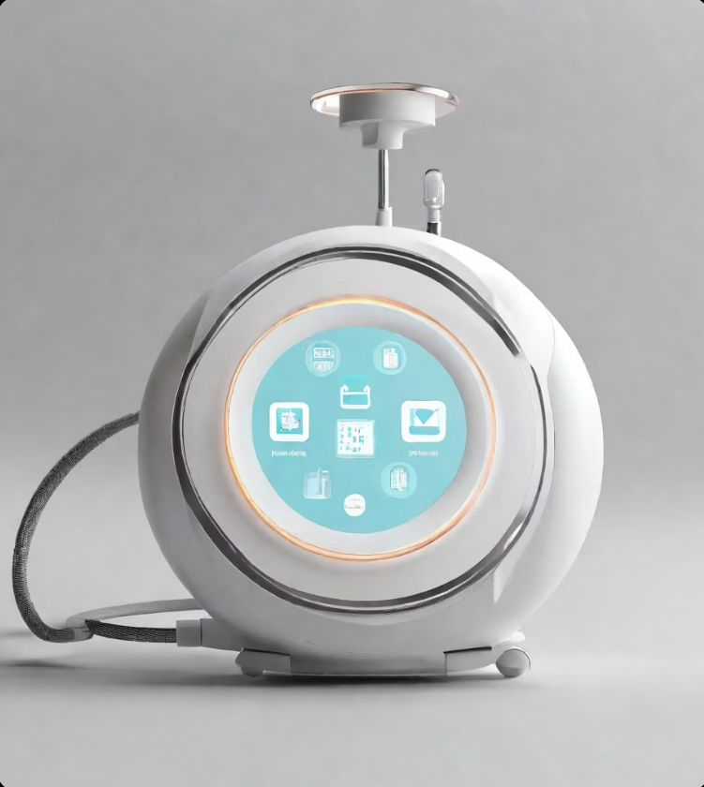
Model Smart IoT Systems for Healthcare

Slide 2
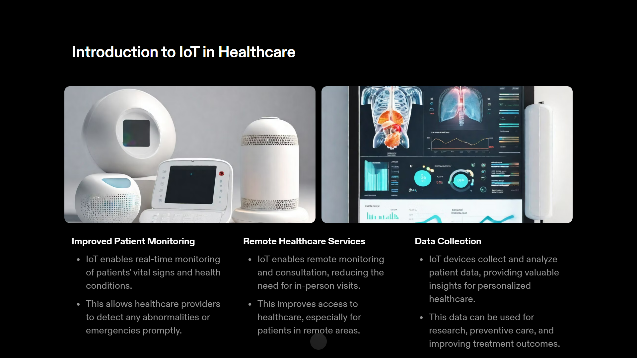
Introduction to IoT in Healthcare
Improved Patient Monitoring
IoT enables real-time monitoring of patients' vital signs and health conditions.
This allows healthcare providers to detect any abnormalities or emergencies promptly.
Remote Healthcare Services
IoT enables remote monitoring and consultation, reducing the need for in-person visits.
This improves access to healthcare, especially for patients in remote areas.

Slide 3
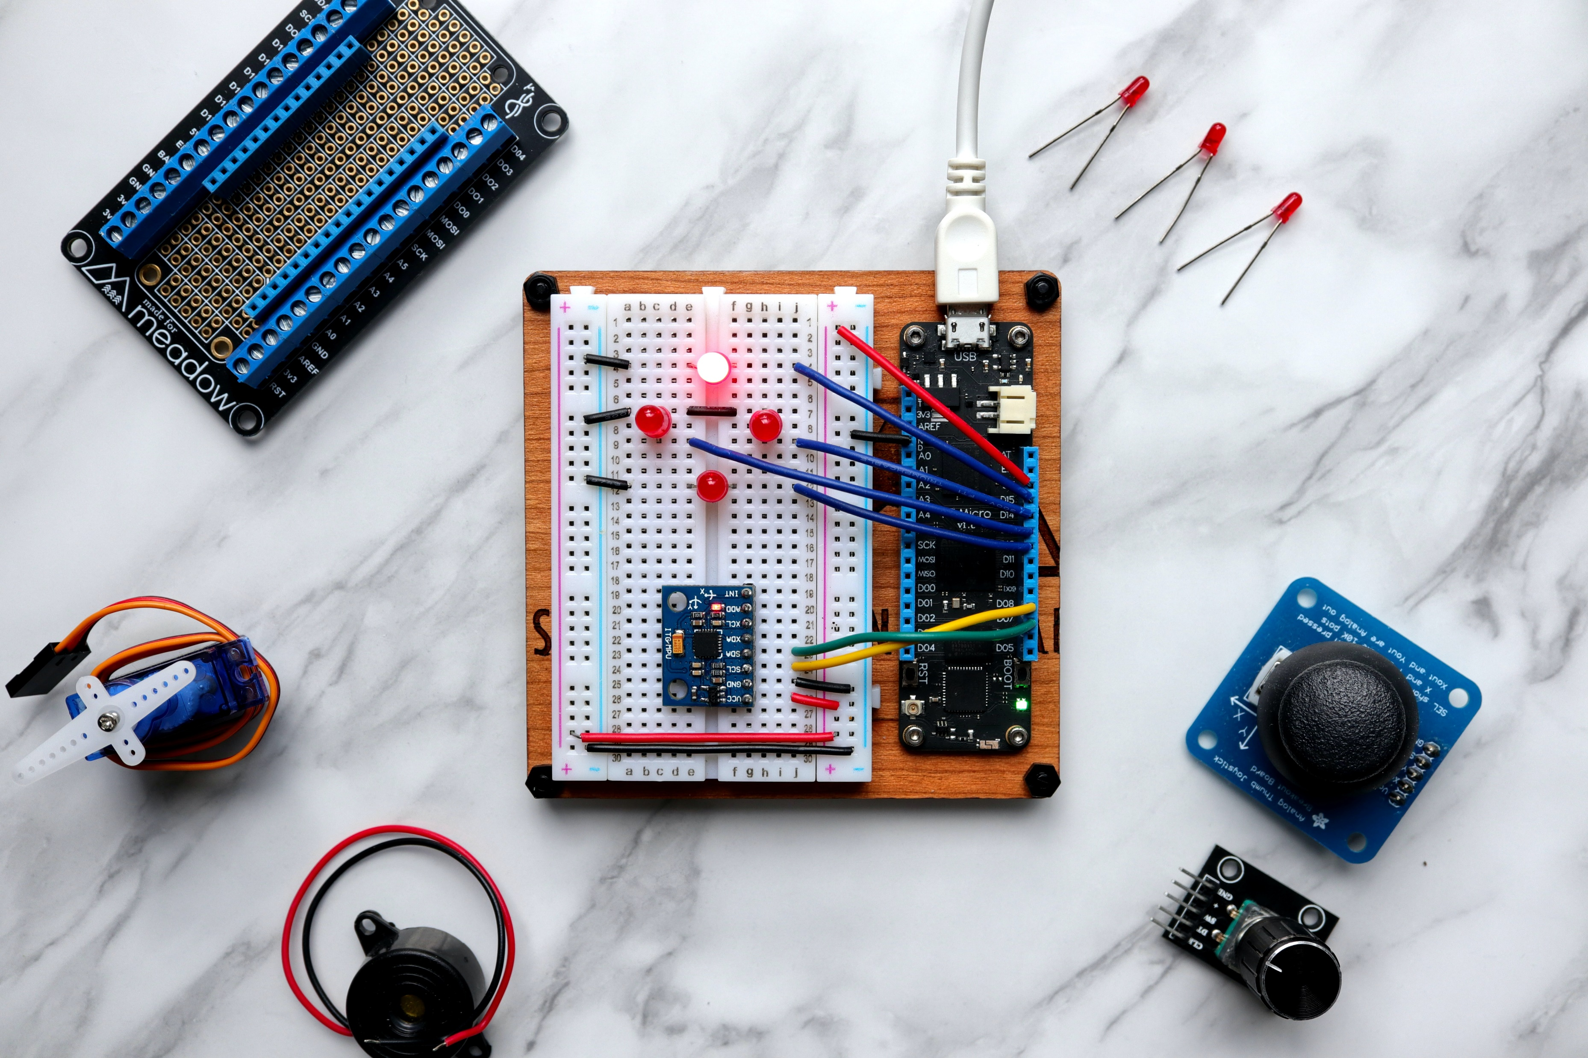
Data Collection
IoT devices collect and analyze patient data, providing valuable insights for personalized healthcare.
This data can be used for research, preventive care, and improving treatment outcomes.

Slide 4
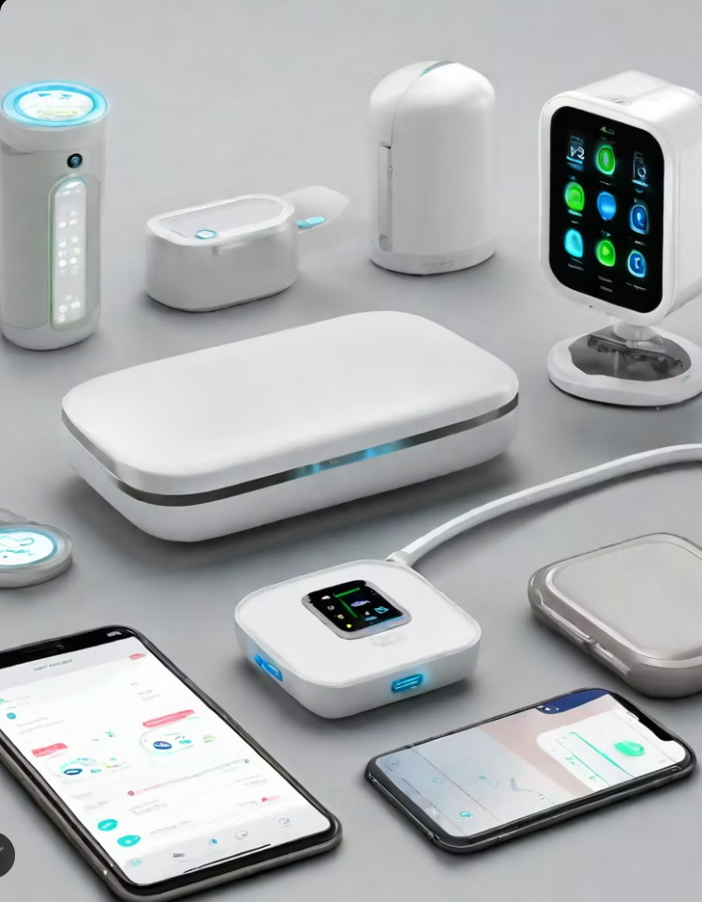
Applications of IoT in Healthcare
Remote Patient Monitoring
Enables healthcare professionals to monitor patients remotely and in real-time.
Improves patient outcomes by allowing early detection of health issues and timely interventions.
Smart Medical Devices
Connected devices that collect and transmit patient data for analysis and monitoring.
Improves accuracy and efficiency in diagnosis and treatment.

Slide 5

Telemedicine Enables
Remote consultations and healthcare services through video conferencing and remote monitoring.
Increases access to healthcare, especially in rural or underserved areas.

Slide 6
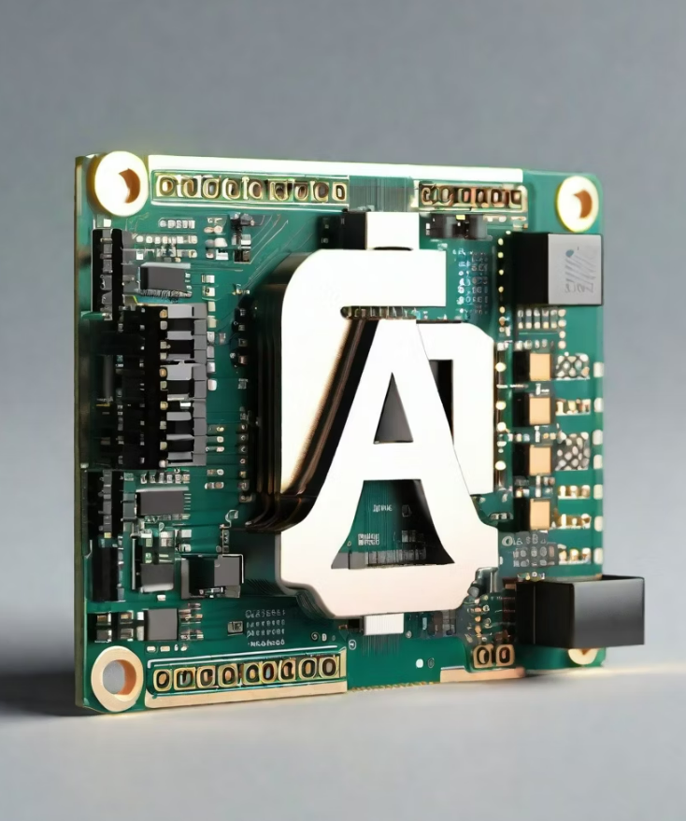
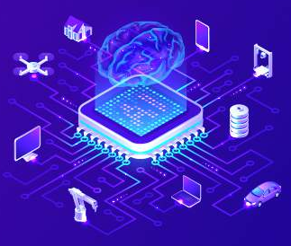
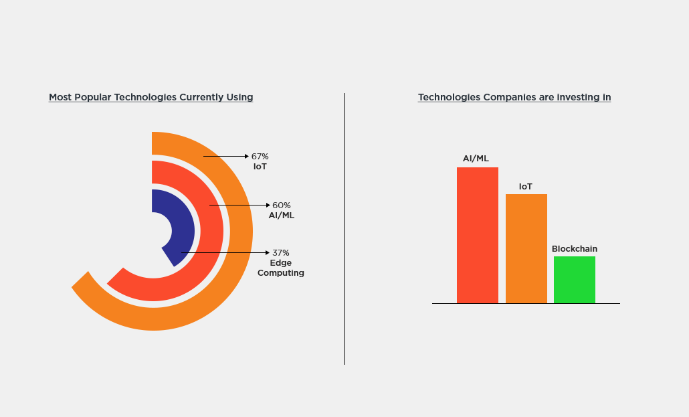
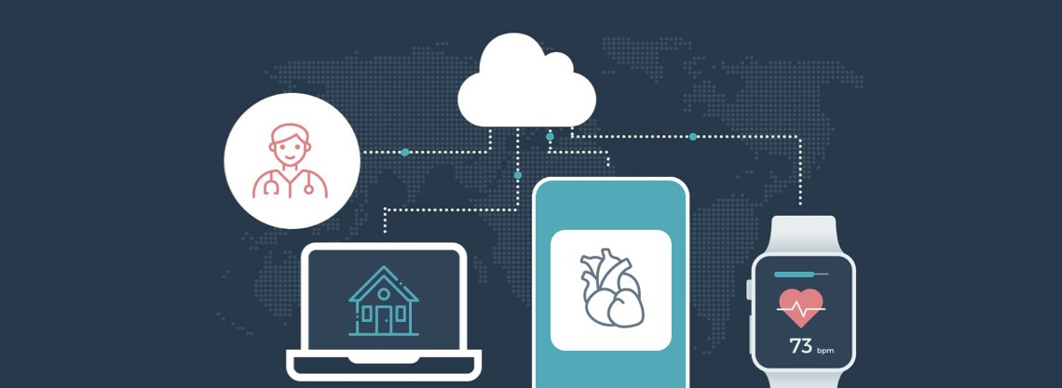
Integration of Arduino and AI
Role of Arduino :
Arduino is used to collect and transmit data in healthcare loT systems.
It can monitor vital signs, track medication adherence, and measure environmental conditions.
Al is utilized for data analysis and decision making in healthcare loT systems.
It can analyze large amounts of data to identify patterns, trends, and anomalies.
Use of Al :

Slide 7
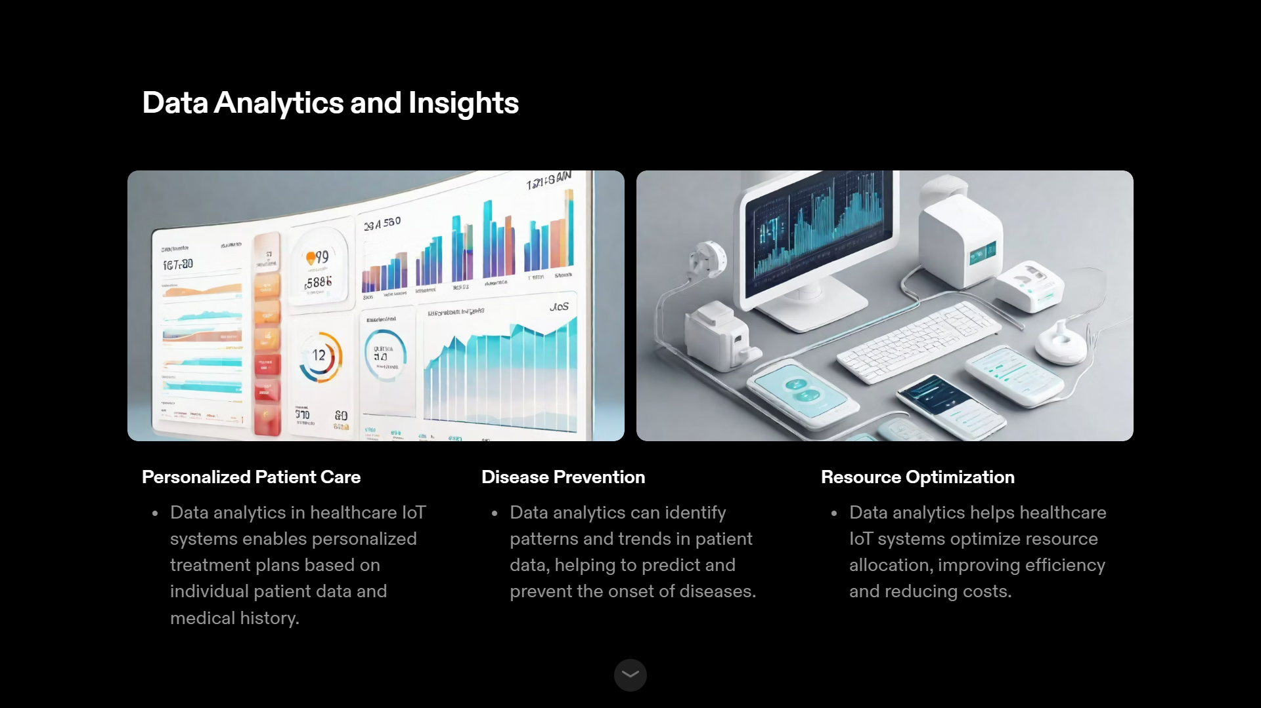
Data Analytics and Insights
Personalized Patient Care:
Data analytics in healthcare loT systems enables personalized treatment plans based on individual patient data and medical history.
Disease Prevention :
Data analytics can identify patterns and trends in patient data, helping to predict and prevent the onset of diseases

Slide 8
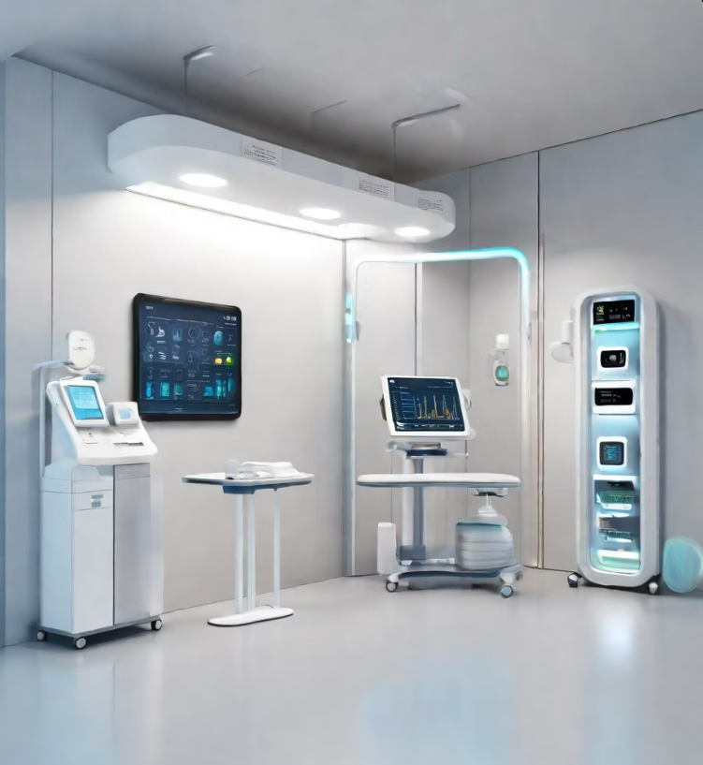
Challenges and Future Directions Challenges :
Data Security
Interoperability
Ethical Considerations
Future Directions :
Advancements in Data Security
Improved Interoperability Standards
Ethical Frameworks and Guidelines
Opportunities for Innovation

Slide 9
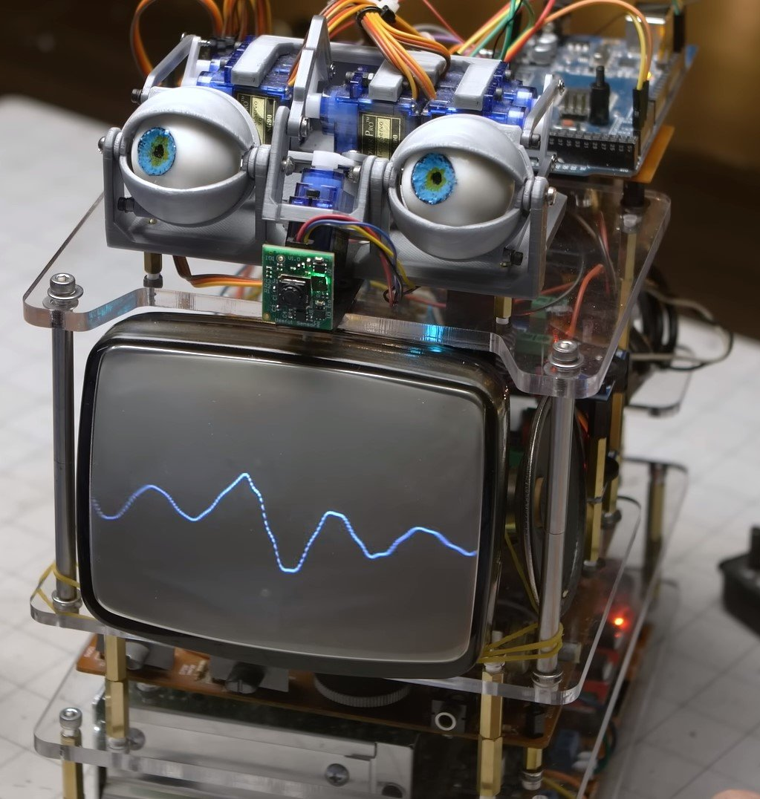
Overview of Arduino and Al
Arduino Technology :
Arduino is an open-source electronics platform that enables rapid prototyping of loT devices.
It allows for easy integration of sensors, actuators, and other components to create smart healthcare devices.
Arduino boards are cost-effective and user-friendly, making them ideal for device prototyping.

Slide 10
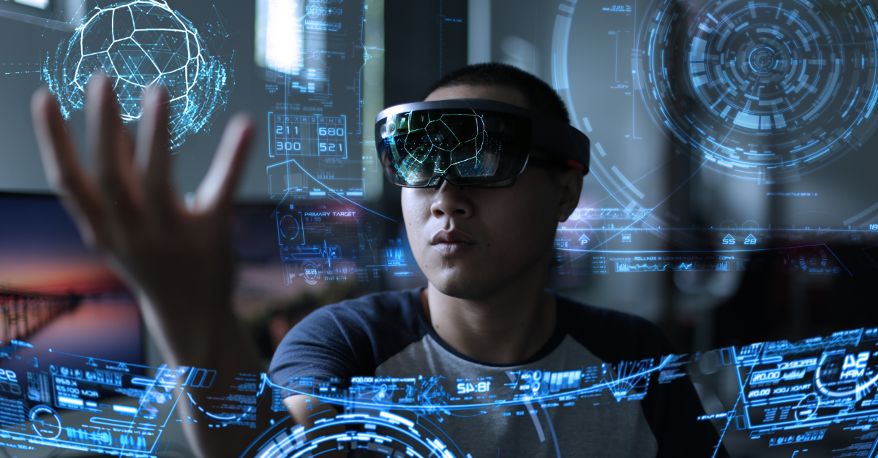
Al Technology
Artificial Intelligence (AI) plays a crucial role in analyzing the data collected by loT devices.
Al algorithms can identify patterns, detect anomalies, and make predictions based on the collected healthcare data.
By leveraging Al, healthcare professionals can gain valuable insights for diagnosis, treatment, and patient monitoring

Slide 11
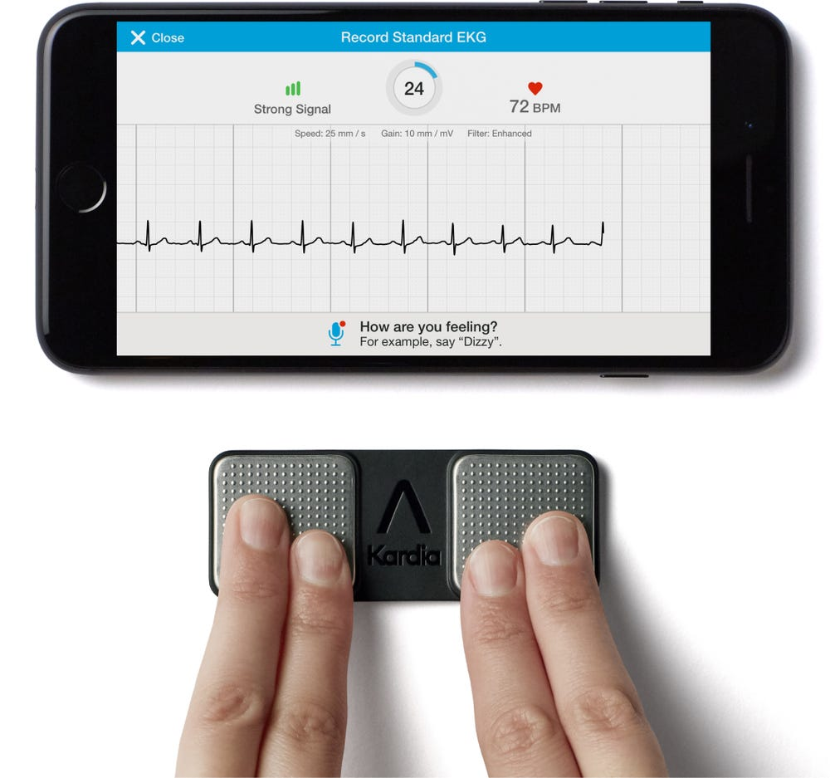
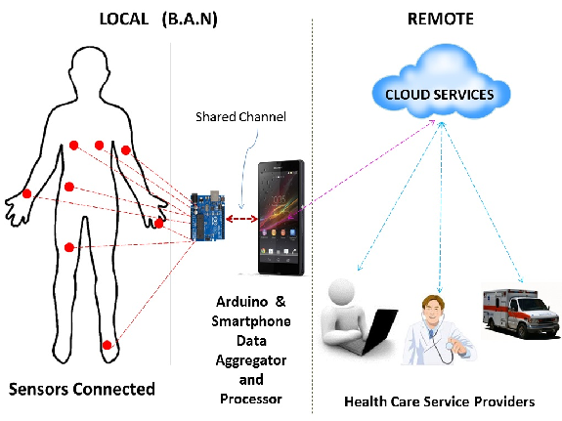
Designing Smart Health Monitoring Devices

Slide 12
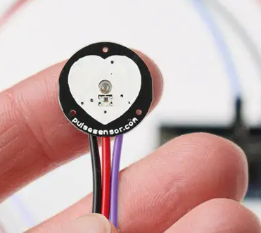
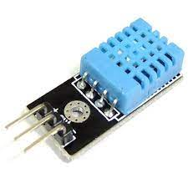
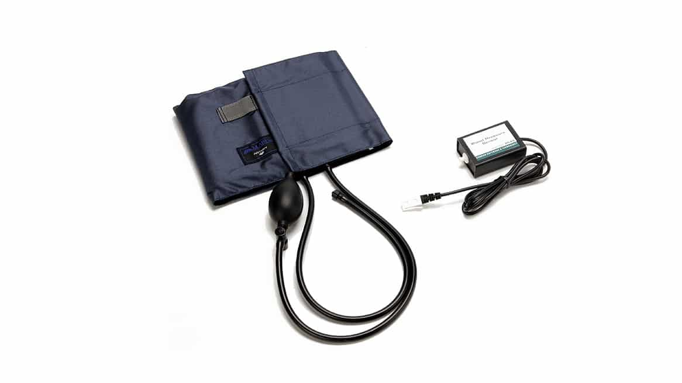
Sensor Selection
Choose sensors that are accurate and reliable for measuring vital signs such as heart rate, blood pressure, and temperature.
Consider the size and form factor of the sensors to ensure they can be comfortably worn or attached to the body.
Ensure the sensors are compatible with the IoT platform and can transmit data wirelessly

Slide 13
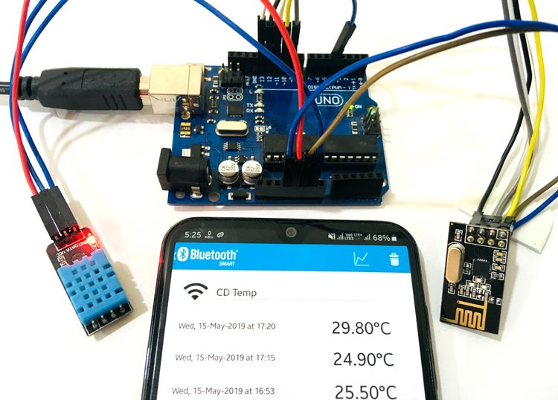
Data Transmission
Choose a reliable and secure communication protocol for transmitting health data, such as Bluetooth or Wi-Fi.
Ensure the IoT platform can handle the volume of data generated by the health monitoring devices and provide real-time analytics.
Implement data encryption and authentication mechanisms to protect the privacy and security of the health data.

Slide 14
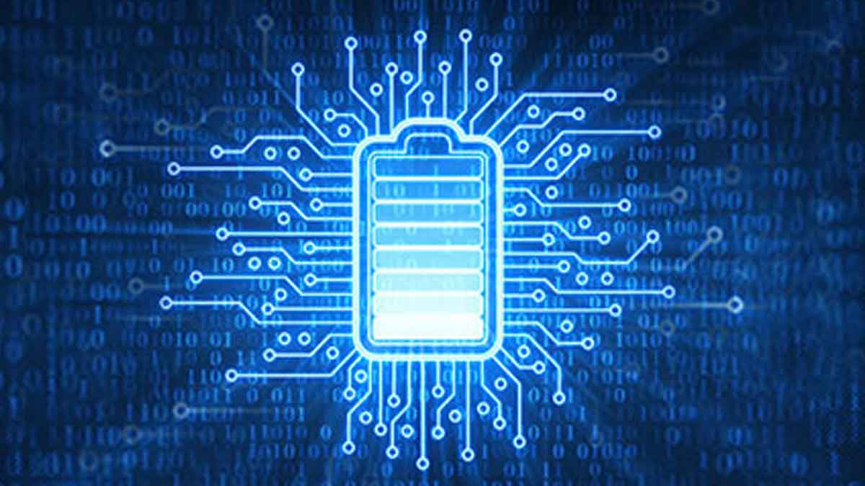
Power Management
Optimize power consumption of the health monitoring devices to prolong battery life and reduce the need for frequent recharging.
Implement power-saving features such as sleep modes and automatic shut-off when not in use.
Consider alternative power sources such as solar or kinetic energy harvesting to supplement or replace batteries.

